Slide 1

Problems on Counting 2013

Slide 2
Reference
Data
Youtube
Code

Slide 3
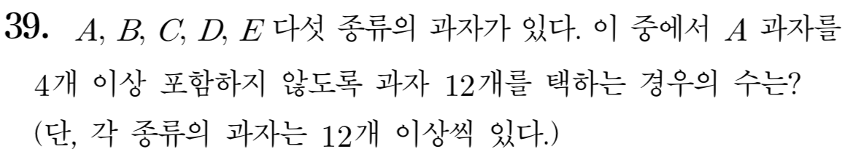
[2013]

Slide 4
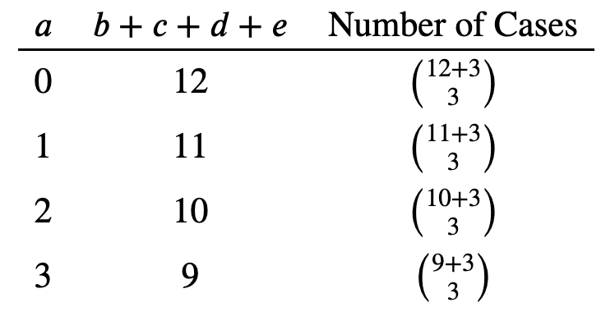


Slide 6

b=0, c=1, d=0, e=2

Slide 7
b=0, c=1, d=0, e=2

Slide 8
b=1, c=0, d=0, e=2

Slide 9
b=1, c=0, d=0, e=2

Slide 11
